Slide 1


Thiranex 20-06-2026
Exploratory Data Analysis of Student Academic Performance
Ansh Gautam

Slide 2






Project Introduction
What is EDA?
Purpose
Importance
Exploratory Data Analysis is the essential process of analyzing datasets to summarize their main characteristics, often employing advanced visual methods.
To uncover underlying patterns, spot anomalies, test hypotheses, and thoroughly check assumptions regarding student academic performance.
Facilitates data-driven decision making, enabling educators and policymakers to implement targeted interventions for overall student success.

Slide 3
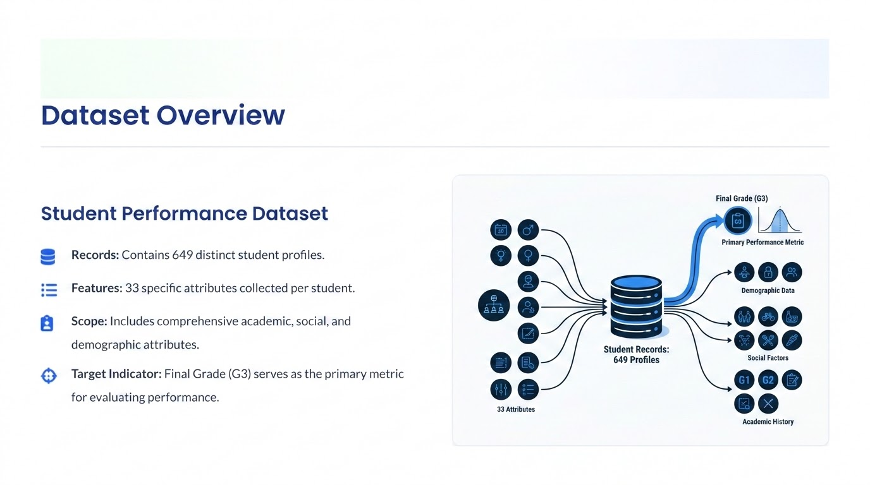

Slide 4


Statistical Summary
Dataset Metrics
Average Age: 16.74 years
11.91
Median Grade: 12
Maximum Grade: 19
Minimum Grade: 0
Average Final Grade
Key Insight
Most students achieved an average level of academic performance.

Slide 5

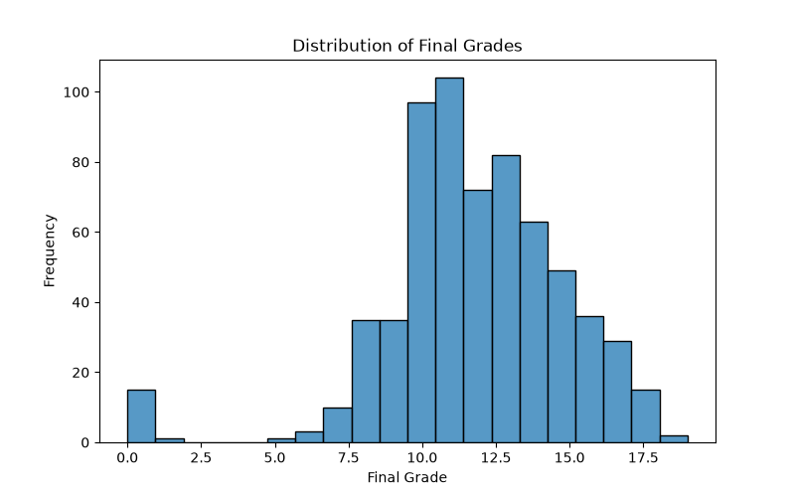
Grade Distribution Analysis
Distribution Insights
Most grades fall prominently between 10 and 15 on the defined grading scale.
The overall distribution closely resembles a normal distribution (bell curve).
There are very few extreme performers at the absolute top or bottom of the scale.

Slide 6
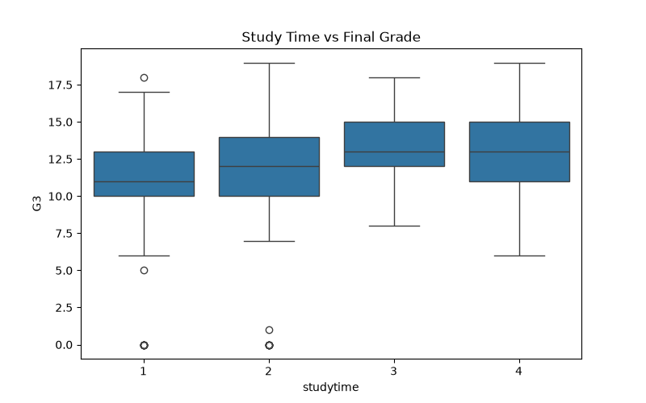

Study Time Impact Analysis
Study Effort vs. Grades
Higher study time corresponds to higher median grades across the entire student population.
There is a consistent positive relationship between dedicated study effort and overall academic success.

Slide 7
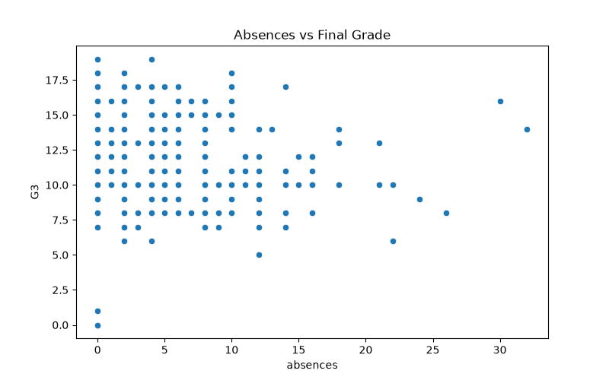
Attendance Impact Analysis
Absences vs. Grades
Students with fewer absences generally perform much better in their final evaluations.
Regular attendance directly influences and improves positive academic outcomes.

Slide 8
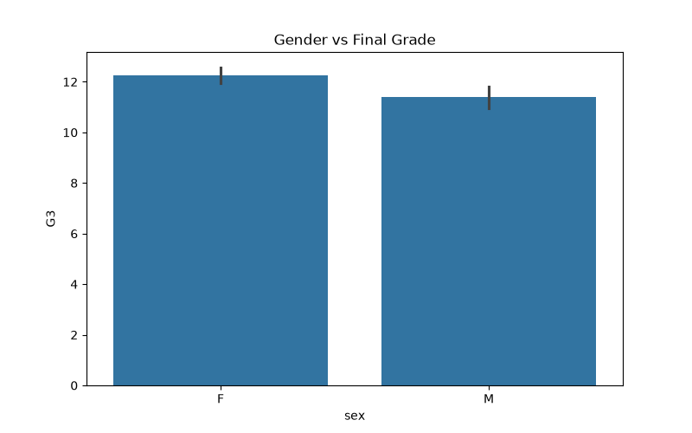
Gender Performance Analysis
Performance by Gender
Female students show slightly higher average grades compared to their male peers.
However, the overall performance difference between genders remains relatively small.

Slide 9
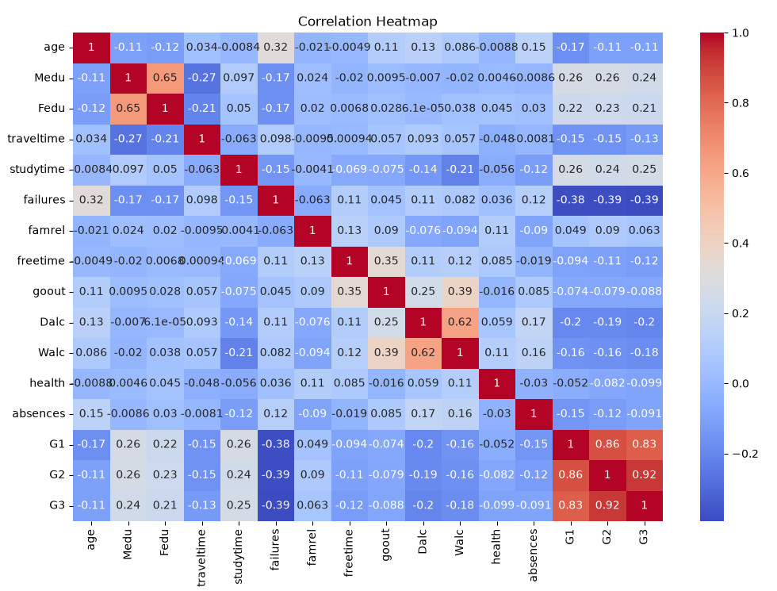



Correlation Analysis
Grade Relationships
G2 to G3
G2 to G3
G1 to G2
G1 to G2
G1 to G3
G1 to G3
Key Conclusion
Previous grades are the strongest statistical indicators of future academic performance.

Slide 10
Key Findings and Conclusion
Study Time: Positively affects academic grades and long-term outcomes.
Absenteeism: Negatively affects grades; higher absences reliably lead to poorer performance.
Prior Achievement: Previous grades strongly predict final grades, while academic failures significantly reduce future performance.
Project Success: EDA successfully identified the major contextual factors affecting student success.
"Exploratory Data Analysis provided valuable insights into academic performance patterns and demonstrated the immense importance of study habits, attendance, and prior achievement in determining overall student outcomes."

